Slide 1

Secure Access to Dataset of Images : CAST-128 CBC Encryption, MAC Verification, and EC El-Gamal Key Delivery
Tareq Sleiman Wadea Tanus
Boris Shoostin
Wael Swaid
Notes:
Wadea 1 – 10
Wael 11-15
Boris 16-21
Tareq 22-29

Slide 2

Table of Contents
Introduction
CAST-128
CBC – Mode
EC El-Gamal
MAC
Cryptosystem as one piece
Advantages and Disadvantages
References

Slide 3

Why Secure Access Matters
Protecting Sensitive Data: Secure access keeps personal and sensitive information safe from unauthorized users.
National Security: Restricted access to sensitive images, like satellite data, protects national interests.
Controlled Access: Only authorized users can view or alter images, based on predefined rules.
Preventing Breaches: Strong security prevents data breaches, avoiding financial loss and reputation damage.
Building Trust: Secure practices earn customer trust and confidence.
Protecting Reputation: Image security shows commitment to privacy, enhancing brand reputation.

Slide 4

Our Goal
Our objective is to create a secure system for encrypting and decrypting images, allowing two individuals to share them safely.

Slide 5

Introduction to CAST-128
CAST is a design procedure for symmetric encryption algorithm developed by Charlisle Adams and Stafford Tavares.
Feistel Cipher Structure

Slide 6
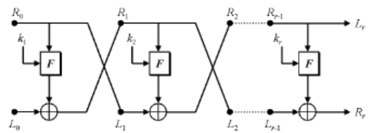
Feistel Cipher Structure parameters
The realization of a Feistel Network depends on the choice of the following parameters and design features
Block Size: larger block sizes mean greater security
Key Size: larger key size means greater security
Number of rounds: multiple rounds offer increasing security
Subkey generation algorithm: greater complexity will lead to greater difficulty of cryptanalysis
Round function: Again, greater complexity generally means greater resistance to cryptanalysis.

Slide 7

CAST - 128 Overview
Definition: CAST-128 is a type of encryption algorithm.
Structure: It uses either 12 or 16 rounds in a special arrangement called a Feistel network.
Specifications: It operates on blocks of data that are 64 bits in size and uses keys ranging from 40 to 128 bits (in 8-bit increments).
Key Length: When the key size exceeds 80 bits, all 16 rounds are utilized.
Components: It comprises several elements including large S-boxes, key-dependent rotations, modular addition and subtraction, and XOR operations.
Round Functions: There are three types of round functions, differing only in specific operations like addition, subtraction, or XOR.

Slide 8

Variable Key Sizes
For key sizes up to and including 80-bits (i.e, 40,48,56,64,72 and 80-bits) uses 12 rounds.
For key sizes greater than 80 bits, the algorithm uses the full 16 rounds
For key sizes less than 128-bits, the key is padded with zerobytes (in the rightmost, or least significant positions)

Slide 9
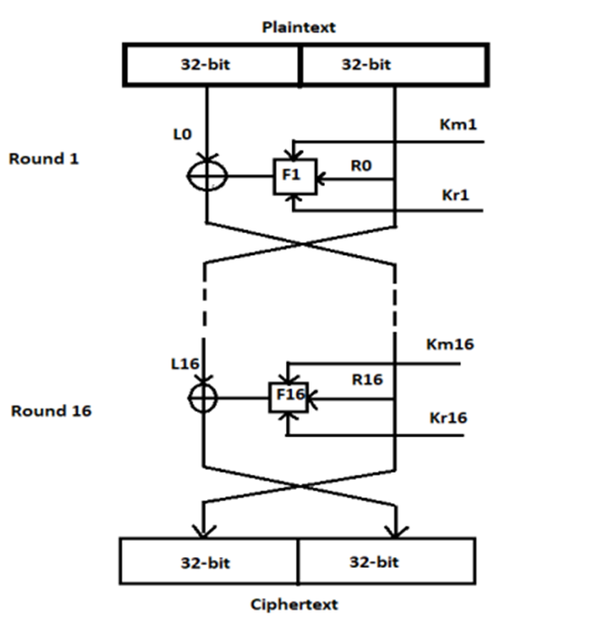
Description of Algorithm
(key schedule) Compute 16 pairs of subkeys {Kmi, Kri} from K (Explained later)
(L0,R0) <-- (m1...m64). (Split the plaintext into left and right 32-bit halves L0 = m1...m32 and R0 = m33...m64.)
(16 rounds) for i from 1 to 16, compute Li and Ri as follows:
Li = Ri-1;
Ri = Li-1 ^ f(Ri-1,Kmi,Kri)
There are 3 types of the function f (Explained later)
c1...c64 <-- (R16,L16). (Exchange final blocks L16, R16 and concatenate to form the ciphertext.)

Slide 10

Decryption
The ciphertext is divided into 64-bit blocks.
The decryption key is expanded into a set of round keys using the same key schedule algorithm used for encryption.
Each 64-bit block is decrypted using the same Feistel network structure used for encryption, but with the round keys applied in reverse order.
In each round, the 64-bit block is divided into two halves, and each half is decrypted using a different round key and a combination of bitwise operations.
After the final round, the resulting 64-bit block is the plaintext.

Slide 11
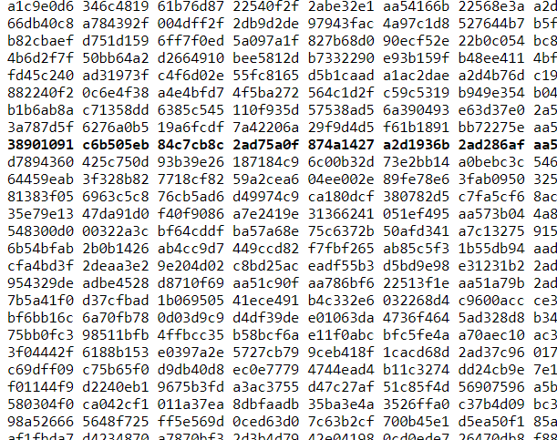
Substitution Boxes
CAST-128 uses eight substitution boxes.
S-boxes S1, S2, S3 and S4 are round function s-boxes.
S-boxes S5, S6, S7 and S8 are key schedule s-boxes
8 S-box require a total of 8 KBytes of storage
only 4 KBytes are required during actual encryption / decryption

Slide 12
Key Schedule
CAST-128 uses a pair of subkeys per round: a 32-bit quantity Km is used as a "masking" key and a 5-bit quantity Kr is used as a "rotation" key.
Let the 128-bit key be x0x1x2x3x4x5x6x7x8x9xAxBxCxDxExF , Let z0..zF be intermediate (temporary) bytes.
Let Si[] represent s-box i and let "^" represent XOR addition.
The subkeys are formed from the key x0x1x2x3x4x5x6x7x8x9xAxBxCxDxExF as follows.

Slide 13
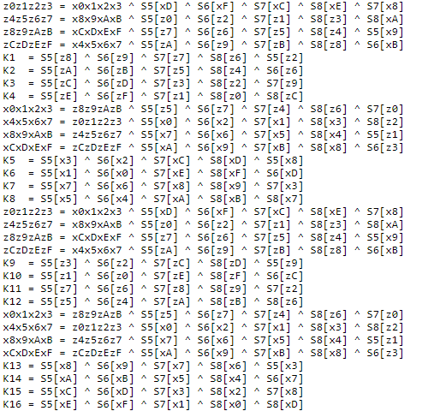
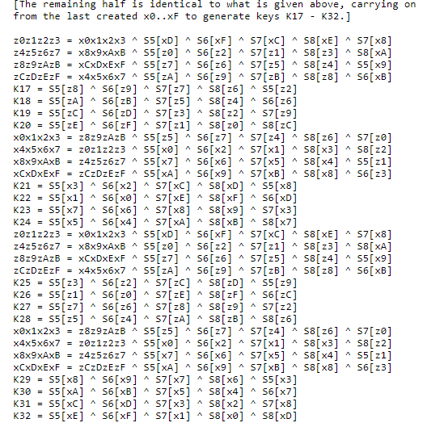

Slide 14
Masking Subkeys And Rotate Subkeys
Let Km1, ..., Km16 be 32-bit masking subkeys (one per round).
Let Kr17,..., Kr32 be 32-bit rotate subkeys (one per round); only the least significant 5 bits are used in each round.
For (i=1;i<=16;i++) {
Kmi = Ki;
Kri = K16+i;
}

Slide 15
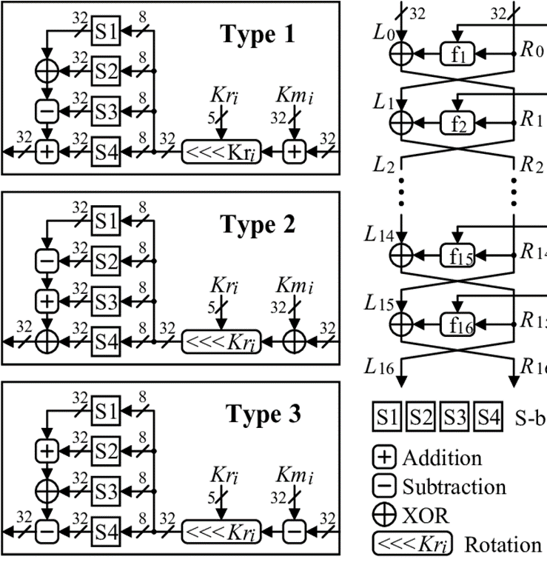
Non-Identical Rounds & Function F
Rounds 1, 4, 7, 10, 13, and 16 use f function Type 1.
Rounds 2, 5, 8, 11, and 14 use f function Type 2.
Rounds 3, 6, 9, 12, and 15 use f function Type 3.
Type 1: I = ((Kmi + D) <<< Kri)
f = ((S1[Ia] ^ S2[Ib]) - S3[Ic]) + S4[Id]
Type 2: I = ((Kmi ^ D) <<< Kri)
f = ((S1[Ia] - S2[Ib]) + S3[Ic]) ^ S4[Id]
Type 3: I = ((Kmi - D) <<< Kri)
f = ((S1[Ia] + S2[Ib]) ^ S3[Ic]) - S4[Id]
Notes:
Three different round functions are used in CAST-128. The rounds are as follows (where "D" is the data input to the f function and "Ia" - "Id" are the most significant byte through least significant byte of I, respectively). Note that "+" and "-" are addition and subtraction modulo 2**32, "^" is bitwise XOR, and "<<<" is the circular left-shift operation.

Slide 16
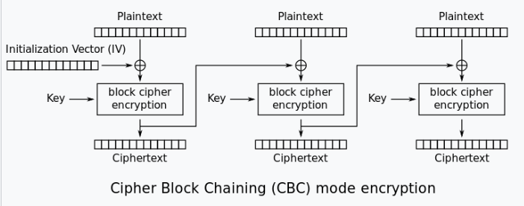
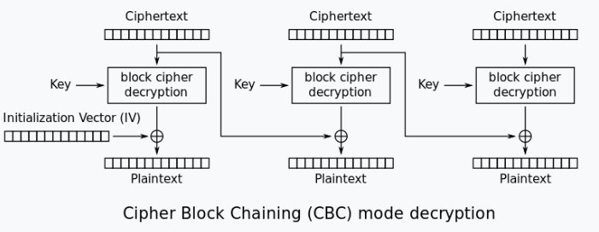
Cipher Block Chaining (CBC)
Unique Start: A random value (IV) is used to kick off the encryption process, making sure the same message encrypts differently each time.
Domino Effect: If anything changes in a block of the original info (plaintext), it messes up all the following encrypted blocks (ciphertext), adding another layer of security.
Notes:
Chaining the Blocks: CBC mode encrypts information in chunks, and before scrambling each chunk (block) with the key, it mixes it with the previous chunk's scrambled version (ciphertext).

Slide 17
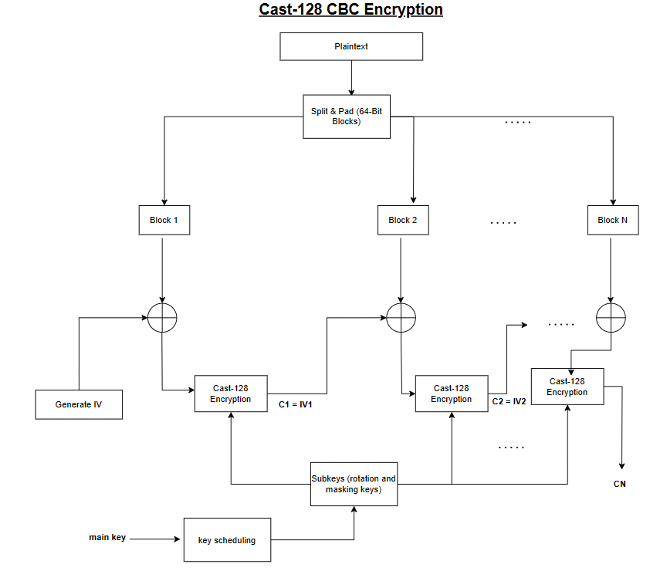
Cast 128 in CBC mode
Notes:
Chaining the Blocks: CBC mode encrypts information in chunks, and before scrambling each chunk (block) with the key, it mixes it with the previous chunk's scrambled version (ciphertext).

Slide 18
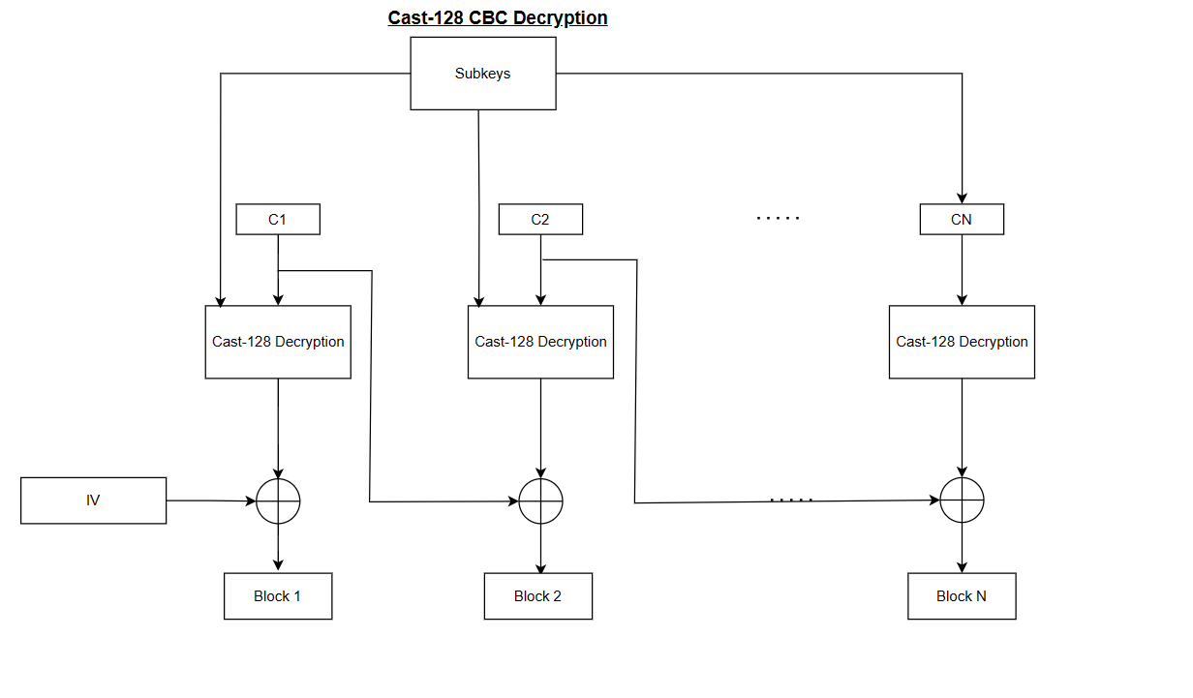
Notes:
Chaining the Blocks: CBC mode encrypts information in chunks, and before scrambling each chunk (block) with the key, it mixes it with the previous chunk's scrambled version (ciphertext).

Slide 19
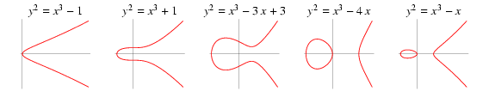
General form of Elliptic Curves
An elliptic curve is a plane curve defined by an equation of the form
We take points on a defined curve (such as Curve 25519) and then perform point addition and subtraction.
The resulting point can be used as a shared secret key exchange protocol.
Let a ∈ ℝ, b ∈ ℝ, be constants such that 4a³ + 27b² ≠ 0.
Examples

Slide 20

ELLIPTIC CURVE EL-GAMAL SECRET KEY DELIVERY
Elliptic Curve ElGamal is a cryptographic method for securely exchanging keys. It uses elliptic curves to generate public and private keys, ensuring strong encryption and confidentiality in communication.
El-Gamal encryption can utilize different elliptic curves, such as NIST curves or specialized curves like Curve25519, chosen based on security and compatibility requirements.

Slide 21

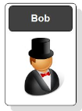
Key Generation and Exchange Process
Let's say Alice wants to send a secret message to Bob securely ( In our case its the key).
Both agree on a base point, B.
Alice and Bob create public and private keys :
Private Key: a
Public Key: P_{A} = a * B
Private Key: b
Public Key: P_{A} = b * B

Slide 22
Key Generation and Exchange Process
Alice takes plaintext message, M, and encodes it onto a point, P_{M}, from the elliptic group
Alice chooses another random integer, a from the interval [1, p-1]
Then Alice sends the following ciphertext:
The ciphertext is a pair of points
P_{C} = [P_{A} , (P_{M} + aP_{B})] = [ (aB), (P_{M} + aP_{B}) ]
P_{C}

Slide 23
Key Generation and Exchange Process
Bob gets the message P_{C}
To decrypt Bob do:
b* P_{A} = b * (aB)
(P_{M} + aP_{B}) – [b(aB)] = P_{M} + a(bB) – b(aB) = P_{M}
Bob then decodes P_{M} to get the message, M ( in our case it’s the Key)

Slide 24

Message Authentication Code
MAC is a mechanism used to ensure the integrity and authenticity of a message, which means verifying that the message has not been altered or tampered with during transmission and confirming that it originates from a trusted source.

Slide 25
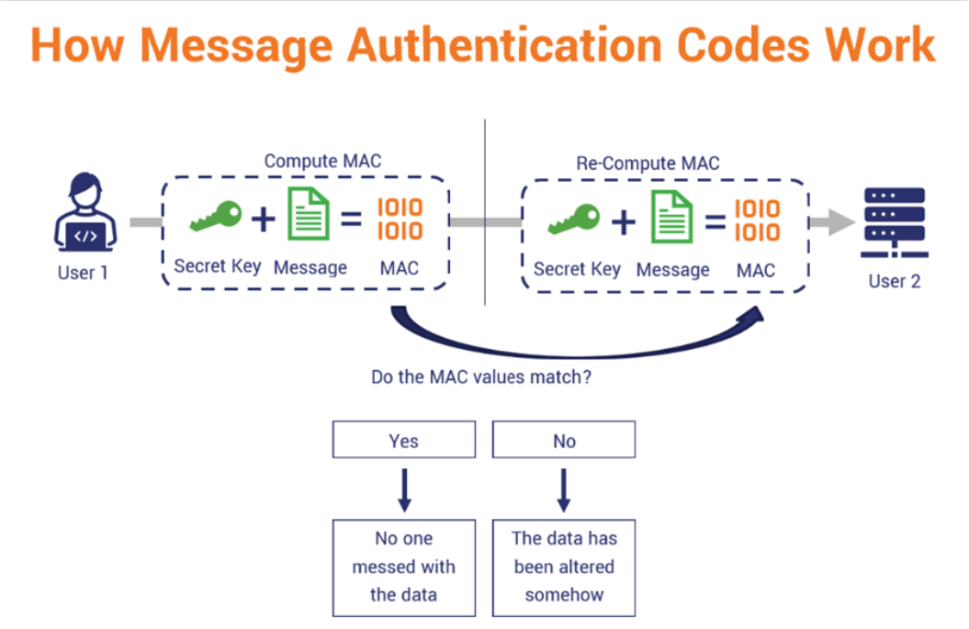

Slide 26
How everything work together?
Alice enters his password to access the dataset.
The system verifies Alice’s password to ensure authentication.
Alice choose image from the dataset
Create mac for original image
Create Keys with Elliptic Curve El-Gamal
Bob decrypted the symmetric key using his private key
The system verifies Bob’s password to ensure authentication.
Bob enters his password to access the dataset.
Create a new file for the encrypted image
Start Encryption step for the image with CAST-128 in CBC Mode
Bob decrypts the ciphertext using CAST-128 in CBC mode.
Create a new file for the decrypted image
Create mac code for decrypted image
Check if they have the same mac.

Slide 27
How everything work together?
Alice enters his password to access the dataset.
The system verifies Alice’s password to ensure authentication.
Alice choose image from the dataset
Create mac for original image
Create Keys with Elliptic Curve El-Gamal
Bob decrypted the symmetric key using his private key
The system verifies Bob’s password to ensure authentication.
Bob enters his password to access the dataset.
Create a new file for the encrypted image
Start Encryption step for the image with CAST-128 in CBC Mode
Bob decrypts the ciphertext using CAST-128 in CBC mode
Create a new file for the decrypted image
Create mac code for decrypted image
Check if they have the same mac.

Slide 28
Advantages
CAST-128:
Strong Security: CAST-128 ensures data stays safe from prying eyes.
Efficient and Flexible: It works quickly and can handle different key sizes, making it useful for many situations.
EC El-Gamal:
Strong Security: Keeps data safe with advanced encryption based on elliptic curves.
Message Authentication Code (MAC):
Data Integrity: Ensures messages haven't been changed.
Authentication: Confirms messages are from trusted sources.

Slide 29
Disadvantages
CAST-128:
Potential Security Concerns: Some experts question its resilience against modern attacks.
Limited Key Flexibility: Supports key sizes only in 8-bit increments.
EC El-Gamal:
Slower Processing: El-Gamal takes a bit longer to encrypt and decrypt keys compared to some other methods.
Message Authentication Code (MAC):
Key Management: Managing and distributing secret keys can be challenging.

Slide 30
Conclusion
In this project we’ve demonstrated secure access to a dataset of images by using CAST-128 in Cipher Block Chaining to encrypt an image or dataset of images. An efficient way of securely exchanging the encryption keys used to encrypt the images using Elliptic Curves El Gamal algorithm, as well as verifying that the integrity of the images have not be been compromised throughout the process of encryption, transfer and decryption of the images by using Message Authentication Code.

Slide 31

References
https://www.rfc-editor.org/rfc/pdfrfc/rfc2144.txt.pdf
https://slideplayer.com/slide/13412335/
https://shorturl.at/flEQX
https://www.allaboutcircuits.com/technical-articles/elliptic-curve-cryptography-in-embedded-systems/
https://en.wikipedia.org/wiki/Message_authentication_code

Slide 32

Mafhoum?
Спасибо

